Slide 1
COBBER
CHECKERS

Slide 2
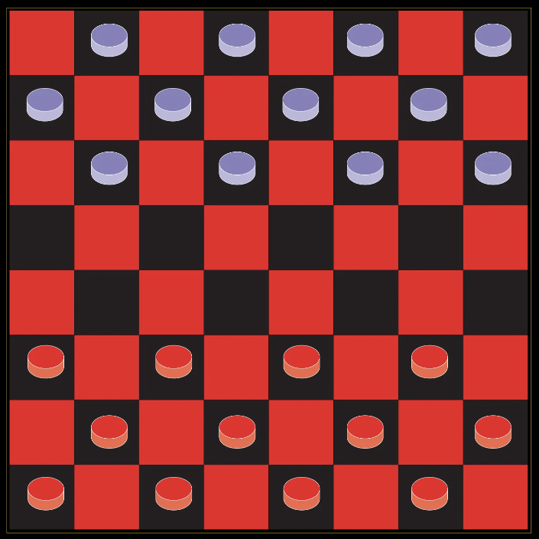
Introduction
Creating cobber checkers because of the lack of any
For bored college students

Slide 3
Work performed thus far
Coming up with our idea
Major screens/ mockups
Code so far

Slide 4
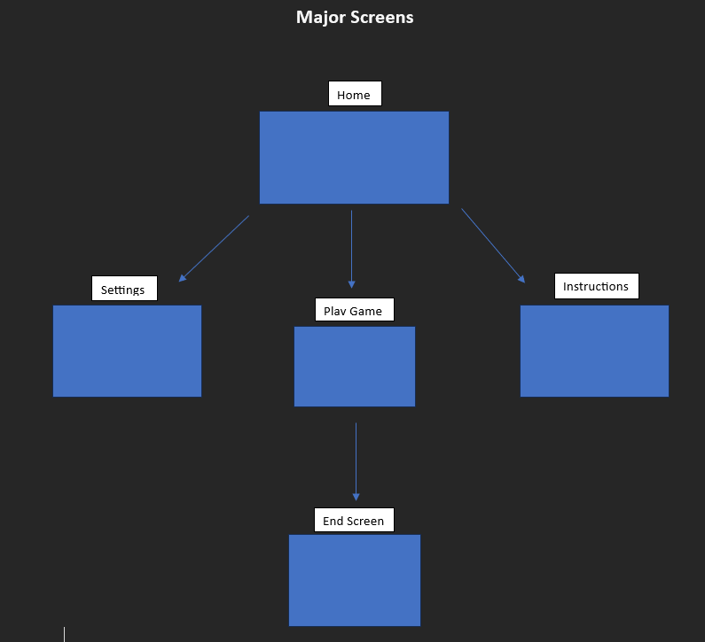
Major Screens
Notes:
Lauryn

Slide 5
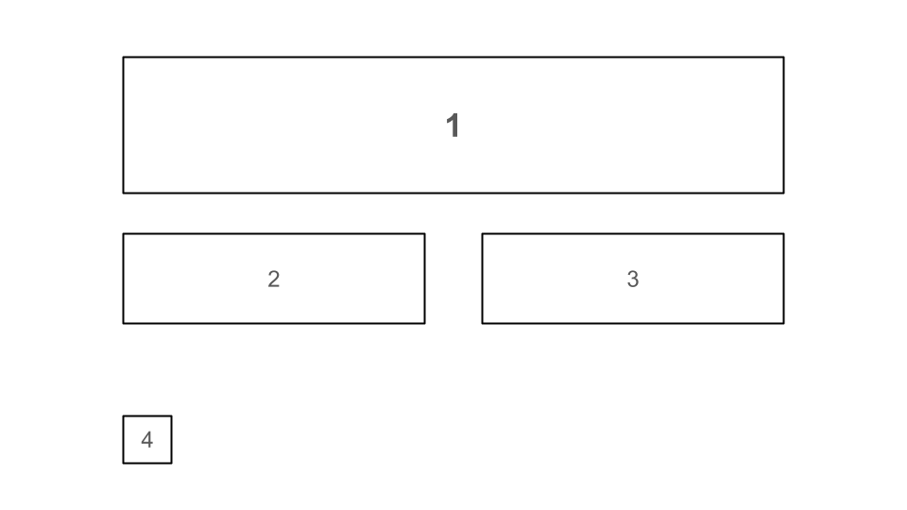
Screen Mockup - Home Page
Component Descriptions
Home Component 1 | Displays the title of the app
Home Component 2 | Starts a new game
Home Component 3 | Goes to the Settings page
Home Component 4 | Goes to the How To Play page
Notes:
Lo

Slide 6
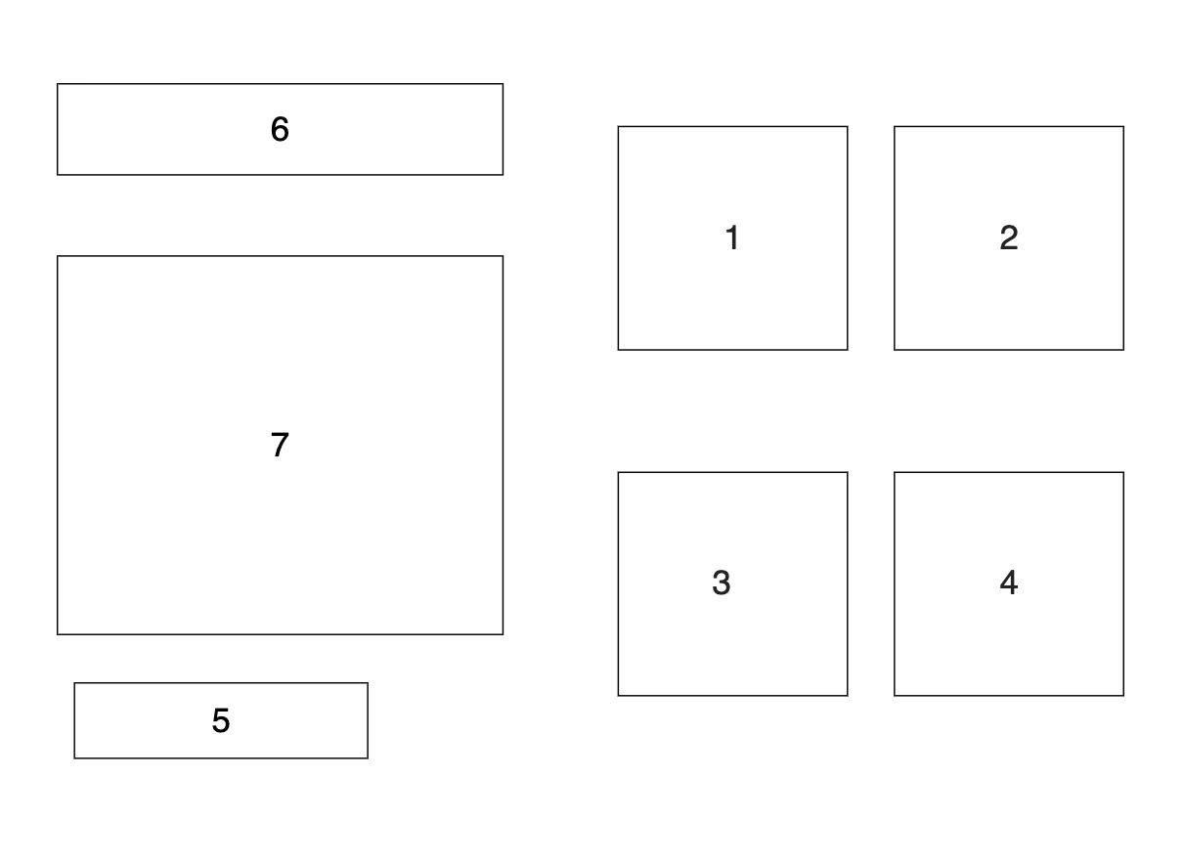
Screen Mockup - How to Play Page
Component Descriptions
HowToPlay1 | Potential Checkers Image
HowToPlay2 | Potential Checkers Image
HowToPlay3 | Potential Checkers Image
HowToPlay4 | Potential Checkers Image
HowToPlay5 | Return to Home Menu Button
HowToPlay6 | Displays title
HowToPlay7 | Description of Checkers Game
Notes:
Ella

Slide 7
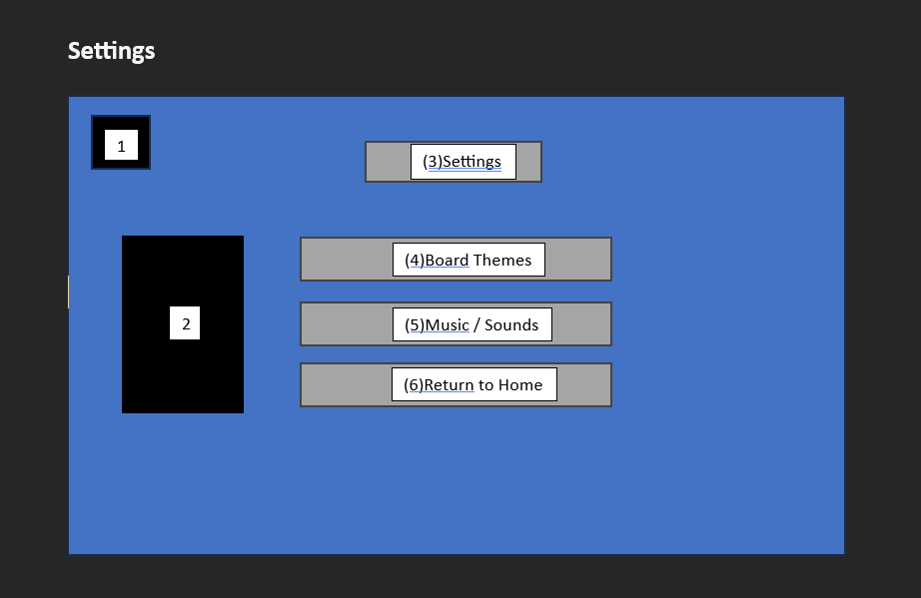
Screen Mockup - Setting Page
Component Descriptions
SettingsPage1 | Settings logo
SettingsPage2 | Cobber Image
SettingsPage3 | Settings Title
SettingsPage4 | Board themes button
SettingsPage5 | Music/Sounds button
SettingsPage6 | Return to home button
Notes:
Lauryn

Slide 8
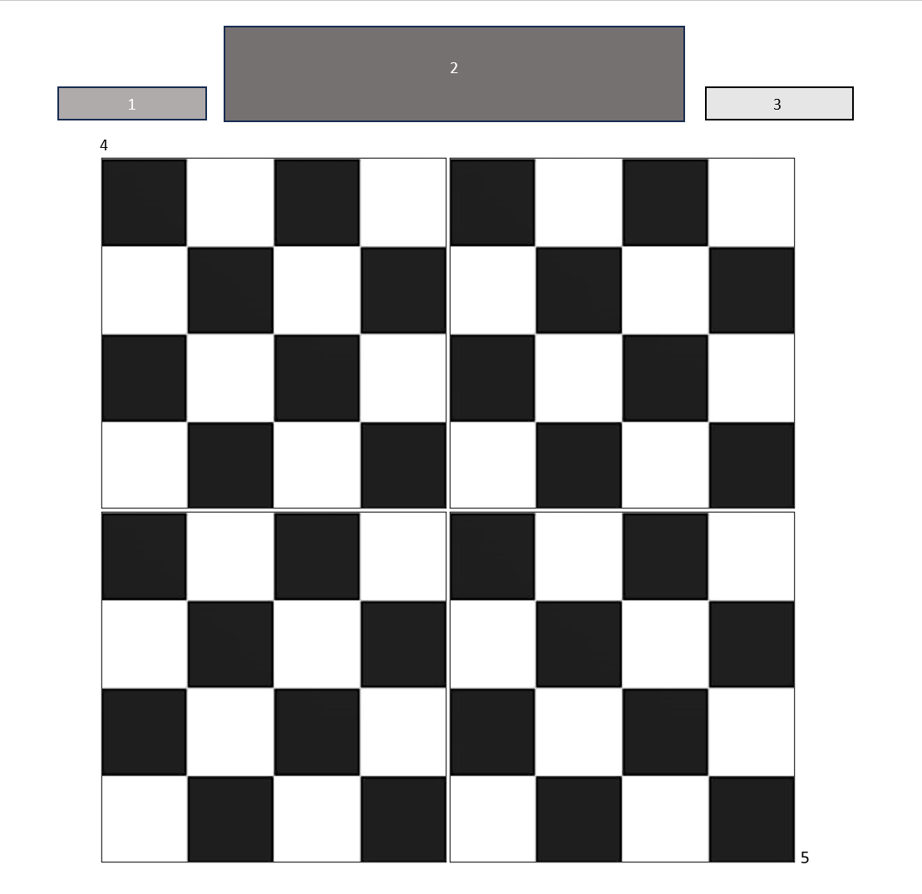
Screen Mockup - Game Page
Component Descriptions
GamePage1 | Return to Home button
GamePage2 | “Checkers”
GamePage3 | Time counter
GamePage4 | Game board
GamePage5 | Spot for stolen pieces
Notes:
Becca

Slide 9
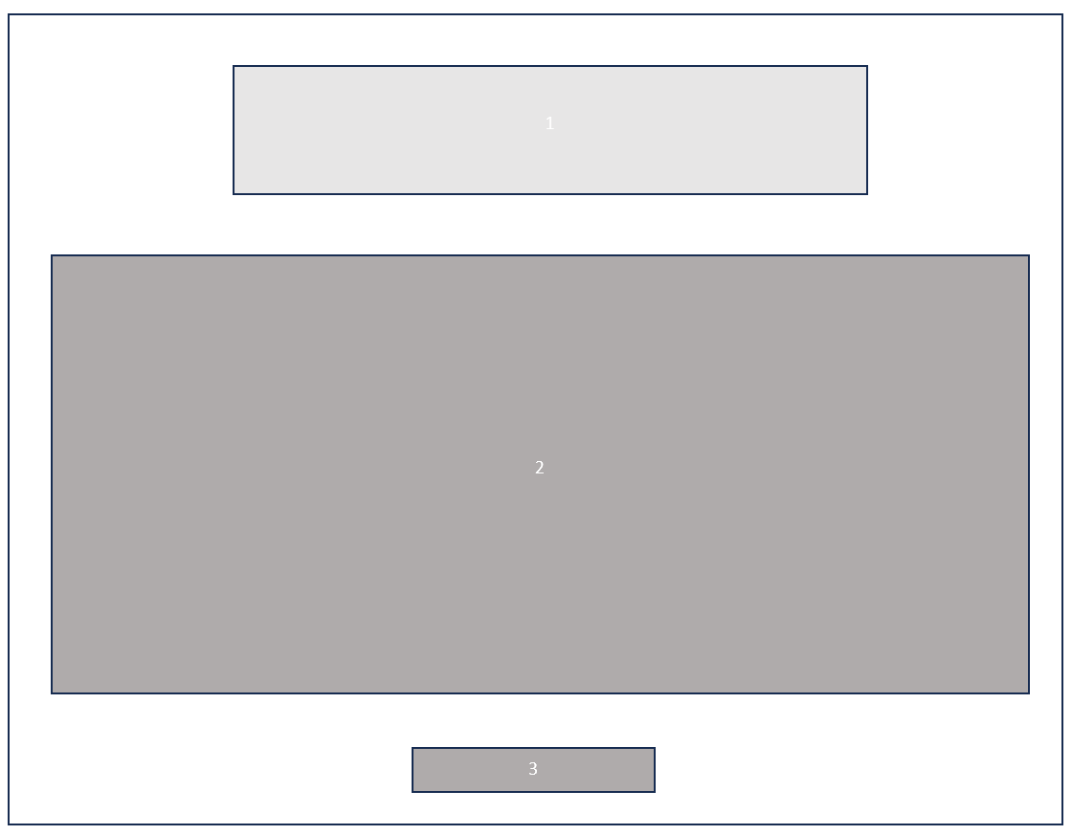
Screen Mockup - End Screen Page
Component Descriptions
EndScreenPage1 | Win/ loss message
EndScreenPage2 | Statistics
EndScreenPage3 | Return to Home button
Notes:
Becca

Slide 10




Pixel Art! (game pieces)
Concordia theme
Kernel Cobb v Niblet theme
Other theme ideas
Colorblind (multiple types)
Pink
Frogs
Super Concordia
Notes:
Becca

Slide 11
What’s gone well!
Code so far
Efficiency
Staying on task
Scheduling
Delegating/ breaking it up

Slide 12
Challenges
Coding challenges
GUI
Scheduling

Slide 13
Plans for further development
Keep working on the code
Experimenting with GitHub as a team
Keep doing what we’re doing

Slide 14
Conclusion
Thanks so much for listening!
#RollCobbs
Notes:
Becca improv

